Slide 1

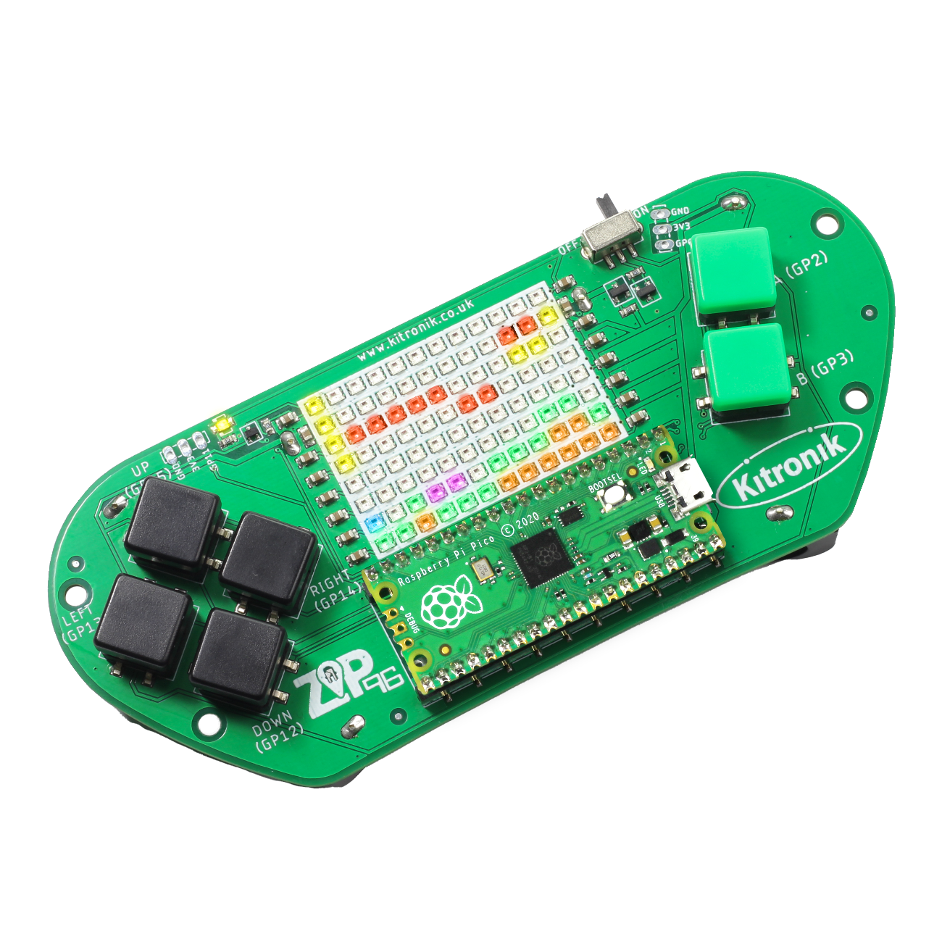
creating the a-mazing game
Computer Science

Slide 2

Aims & objectives
Computer Science
By the end of this lesson you will have:
Looked at taking physical inputs from the Pico ZIP96.
Used the inputs to control the player movement.

Slide 3
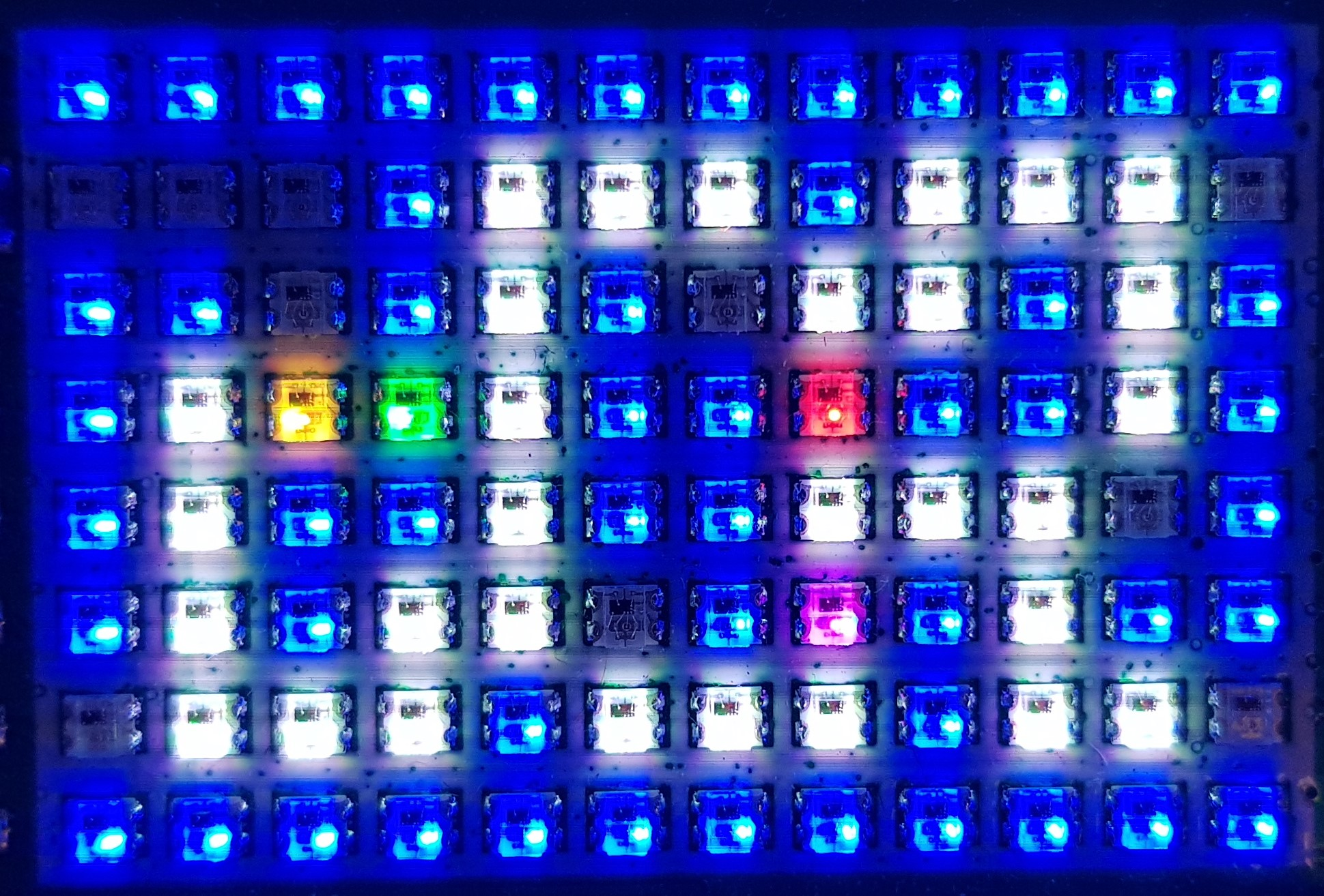
What is our a-mazing game?
Computer Science
A maze-based game where the player runs through a maze collecting gems – collect all the gems to win.
Three different enemies move around the maze as well, trying to stop the player from collecting gems.
One enemy moves randomly, one simply tries to move towards the player, the final one is smart and finds the best path through the maze to the player.
If an enemy catches the player, they lose a life. Once all three lives are lost… game over!

Slide 4
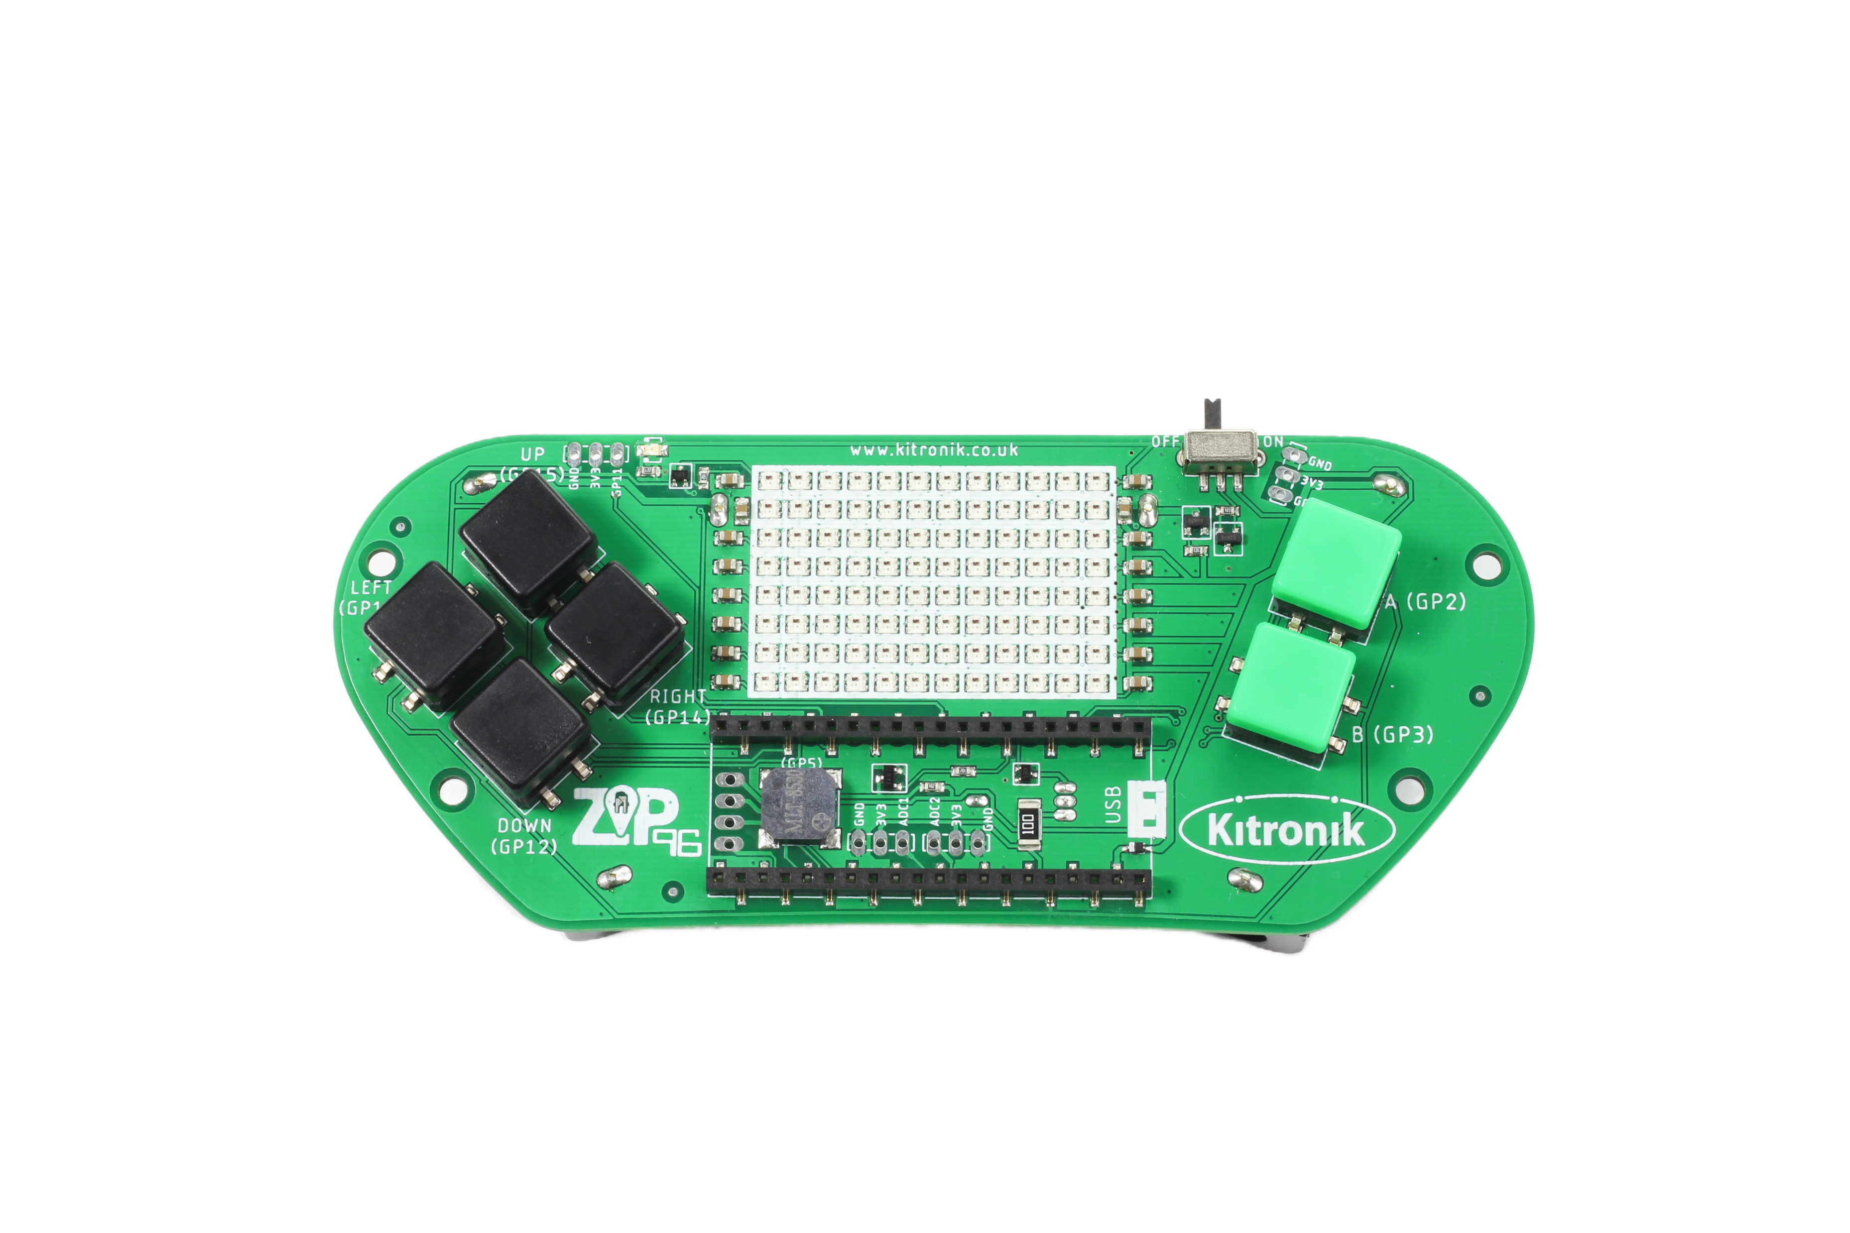
Thonny setup
Computer Science
Connect Pico ZIP96 to computer using a USB cable and open Thonny.

Slide 5
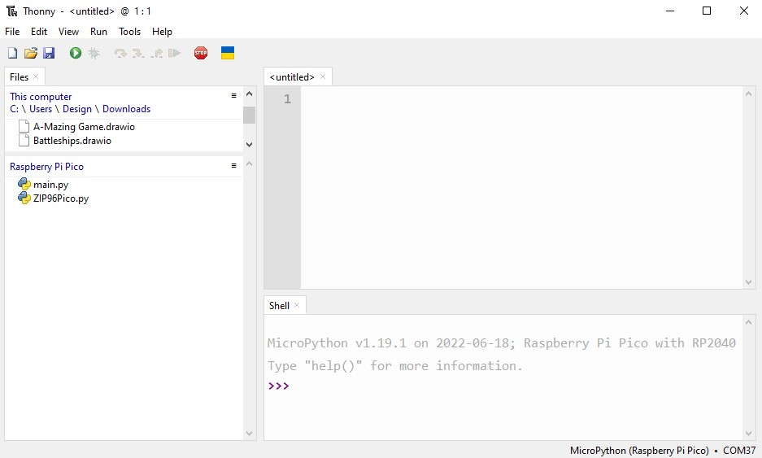
Thonny setup
Computer Science
Check the Pico device appears in the bottom right corner of Thonny.
Try pressing STOP if it does not appear automatically.
Turn on the ‘Shell’ by going to ‘View > Shell’.

Slide 6
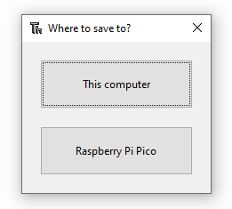
Thonny setup
Computer Science
Create a new file by clicking ‘File > New’.
Save it to the Pico by clicking ‘File > Save as’ and then select ‘Raspberry Pi Pico’.
Name the file ‘main.py’.

Slide 7
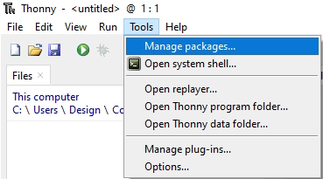
Thonny setup
Computer Science
Install the ‘ZIP96Pico’ library onto the Pico.
Click on ‘Tools > Manage Packages…’

Slide 8
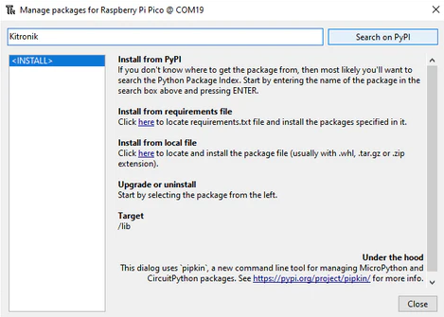
Thonny Setup
Computer Science
With the ‘Manage packages’ window open, search for ‘Kitronik’ and click the ‘Search on PyPI’ button.
Locate ‘KitronikPicoZIP96’ in the list of search results, then click the ‘Install’ button.
Confirm the install by clicking ‘Yes’ if prompted by Thonny.

Slide 9
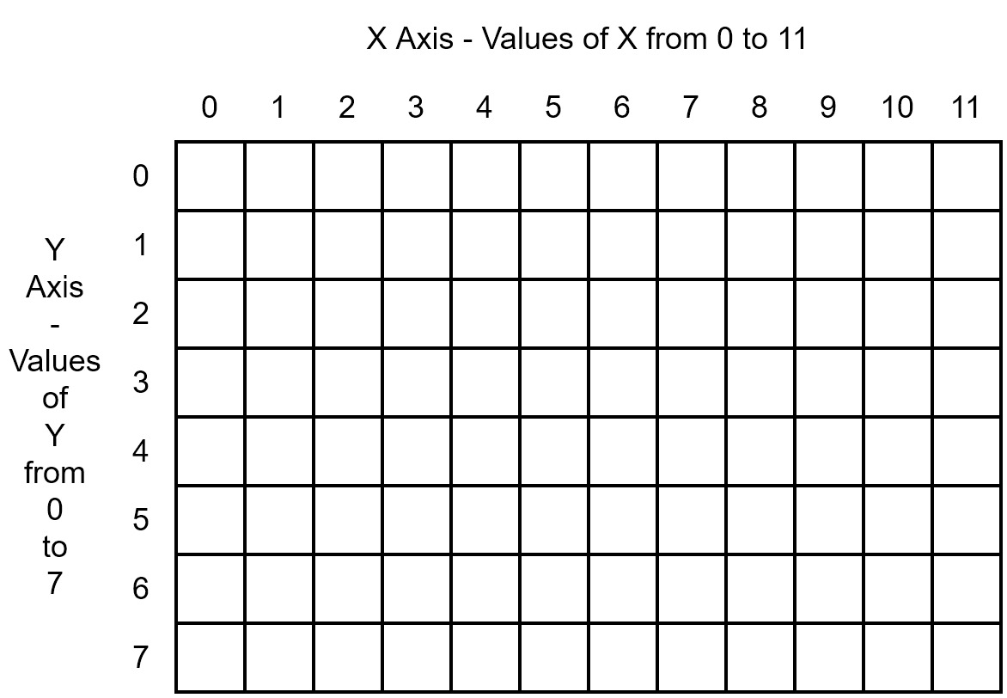
Pico zip96 screen layout
Computer Science

Slide 10

Pico zip96 screen layout
Computer Science
What feature of the Pico ZIP96 can we use to control the players movements?

Slide 11
Coding: add game variables
Computer Science
At the end of the file, add in the game variables:
# Show the created objects on the screen
screen.show()
# Setup game variables
moveDelay = 0.5
moveX = 1
moveY = 0

Slide 12
Coding: create game loop
Computer Science
After the new game variables, start the game loop:
# Start game loop
while 1:
# Wait for moveDelay before moving
sleep(moveDelay)

Slide 13
Coding: pico zip96 button input
Computer Science
After the delay in the game loop:
# When up pressed,
# change player y position by -1
if (gamer.Up.pressed()):
moveX = 0
moveY = -1
# When down pressed,
# change player y position by 1
if (gamer.Down.pressed()):
moveX = 0
moveY = 1
# When left pressed,
# change player x position by -1
if (gamer.Left.pressed()):
moveX = -1
moveY = 0
# When right pressed,
# change player x position by 1
if (gamer.Right.pressed()):
moveX = 1
moveY = 0

Slide 14
Coding: update player position
Computer Science
After the button input code:
# Update the player position using the move values
player.move(moveX, moveY)
# Show the updates on the screen
screen.show()
Run the program and test player movement with the buttons

Slide 15
Coding: update player position
Computer Science
How can we fix the issue where the player leaves a trail as they move around the screen?

Slide 16
Coding: Clearing the screen
Computer Science
After the draw() function, define a new function:
At the beginning of the move() function, call drawEmpty():
# Draw a blank space in the current position on the screen
def drawEmpty(self):
self.screen.setLEDMatrix(self.x, self.y, self.screen.BLACK)
def move(self, x, y):
# Reset the current position on the screen
self.drawEmpty()

Slide 17
Over the edge!
Computer Science
What are some possible solutions for stopping the player moving off the edge of the screen?

Slide 18
Coding: Screen boundaries
Computer Science
Inside the move() function, before calling draw():
# Check the new x position is valid (not off the edge of the screen)
if (self.x < 0): self.x = self.screenWidth - 1
if (self.x >= self.screenWidth): self.x = 0
# Check the new y position is valid (not off the edge of the screen)
if (self.y < 0): self.y = self.screenHeight - 1
if (self.y >= self.screenHeight): self.y = 0
Run the program and test player movement with the buttons – can the player still disappear?

Slide 19
conclusion
Computer Science
In this lesson you have:
Used a while loop to read user inputs from the Pico ZIP96.
Used if statements to control the game flow.
Responded to user inputs by updating objects on the screen.
Called methods on the Player object.
Checked position of Player object is within bounds of the maze.

